Slide 1
Large Language Models
Rushendra Sidibomma

Slide 2

About me…
Bachelors in CS with Honors from IIIT Sri City (‘24)
Undergraduate Researcher under Dr. RK Sanodiya
Recipient of $9,000 research fellowship (@ TMU)
Member @ Trustworthy AI Lab
ML Research Engineer @ AutomationEdge
Research Interests: Trustworthy ML, Vision, LLMs (reasoning, weakly-supervised tasks, low-resource tasks)
https://rushendra10.github.io/

Slide 3
About this presentation…
Interactive - Please me super active in the chat
Ask questions at any point of time - chat window on screen
We can have quick tangent discussions
Reasonable sidebars are okay - longer discussions can be pushed to the end
If some question is too long to put down in chat, I can unmute you

Slide 4
Introduction to LLMs

Slide 5
What are LLMs?
Large Language Models are simply models that calculate the probability of a word being the next token in a sequence(sentence).
Built using deep learning architectures, especially Transformers (e.g., GPT, BERT).
LLMs are not just basic pattern matchers; they generalize from context.
Example: GPT-4 can write essays, summarize legal documents, and answer programming questions.

Slide 6
Why Learn About LLMs Now?
LLMs are central to the current wave of AI innovation. Everyone knows AI is being adopted everywhere right?
Essential for staying competitive in tech and knowledge-driven industries.
Helps build AI literacy—crucial in the age of generative AI.
Just as computers were once optional but are now essential, knowing how LLMs work is becoming foundational.

Slide 7
Current Trends in LLM Development
Emergence of multimodal models (text + images/audio/video, e.g., GPT-4o).
Open-source LLMs gaining traction (e.g., Mistral, LLaMA).
Shift toward smaller, more efficient models (e.g., quantization, fine-tuning).
Focus on safety, alignment, and explainability in LLM outputs.
Integration into enterprise workflows and productivity tools.
Highlight ChatGPT plugins, Microsoft Copilot, Google Gemini, and their widespread adoption.
Fine-tuning and retrieval-augmented generation (RAG) as growing techniques.

Slide 8
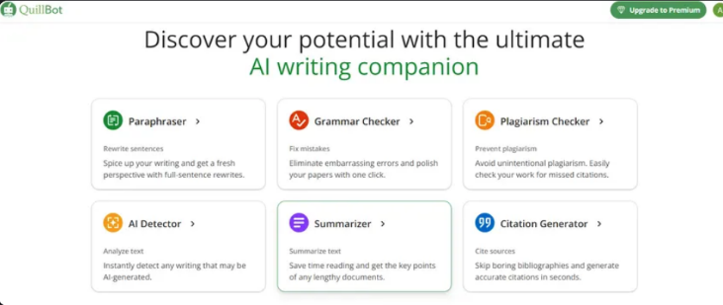
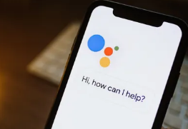

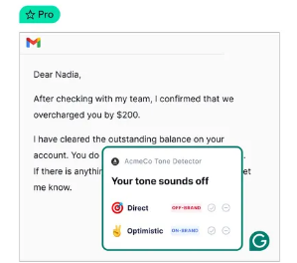
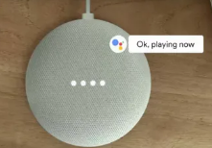
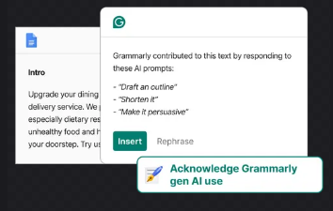
Applications of LLMs in Daily Life

Slide 9
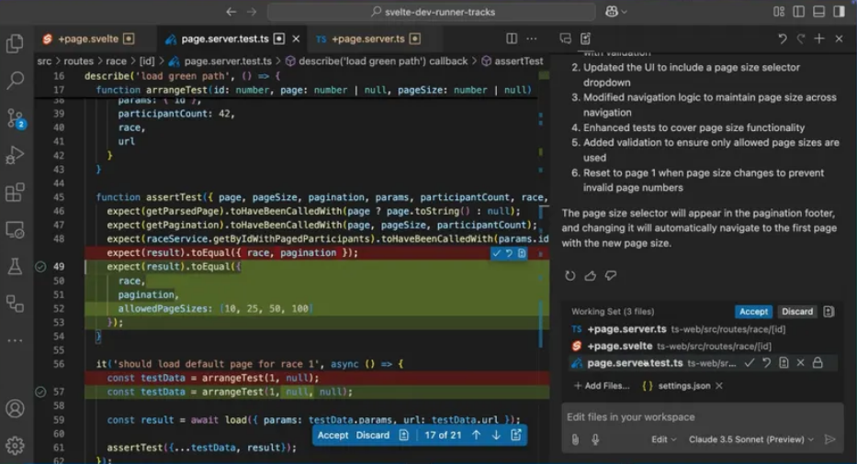

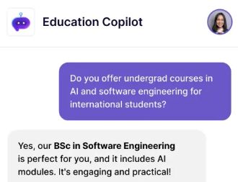
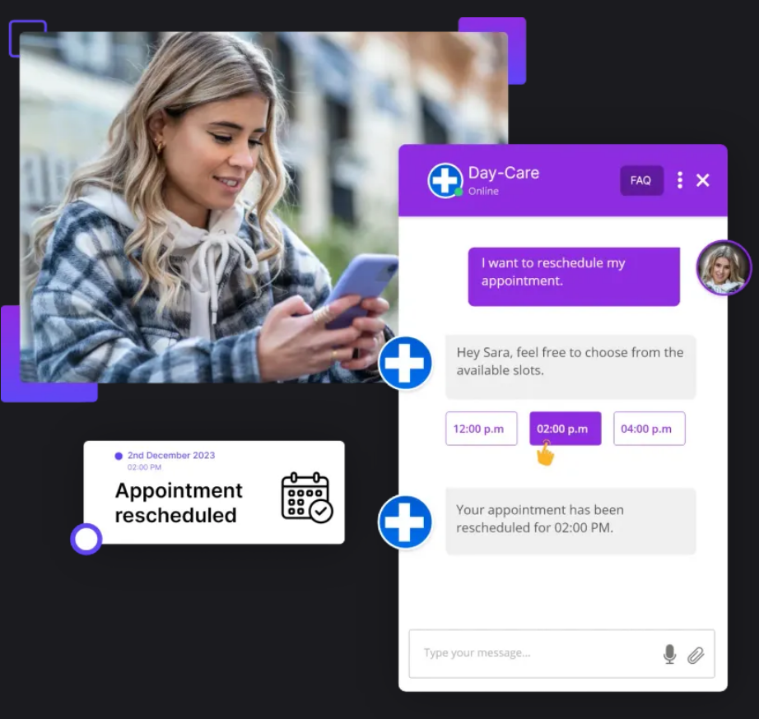
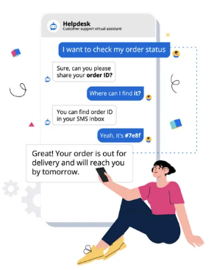
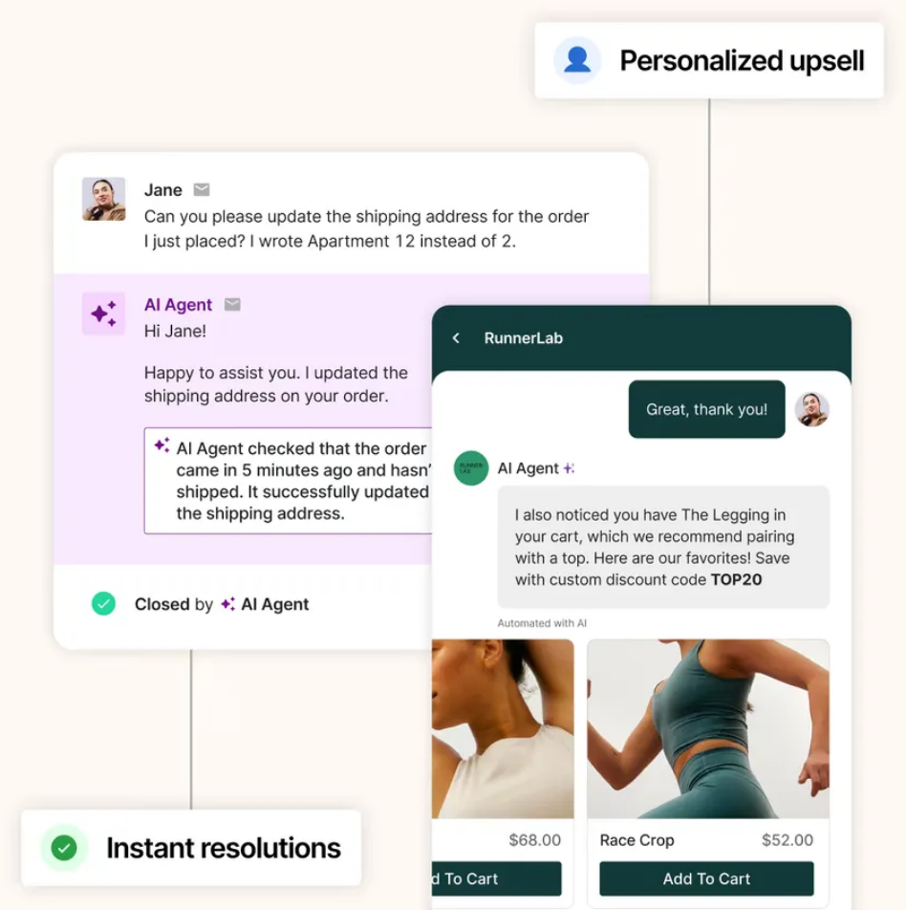
Applications of LLMs in different industries

Slide 10
Transformers
&
Transformer architecture

Slide 11
Introduction to Sequence Models: From RNNs to Transformers
Traditional models: RNNs and LSTMs
Both process sequences step-by-step.
Effective for short-term dependencies, but struggle with long-range context.
Transformers revolutionized NLP by replacing recurrence with attention.
“Attention Is All You Need” (Vaswani et al., 2017)

Slide 12
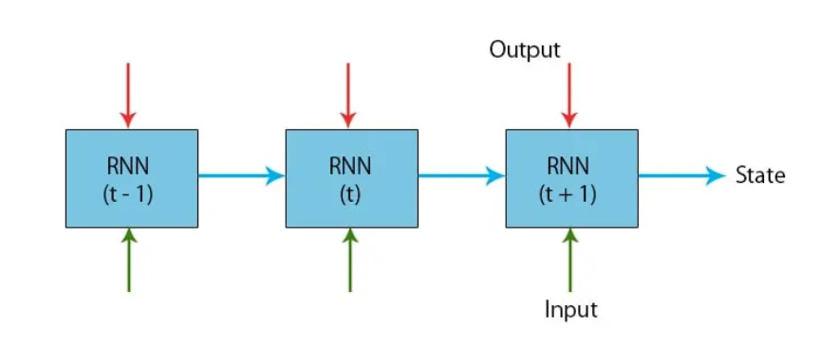
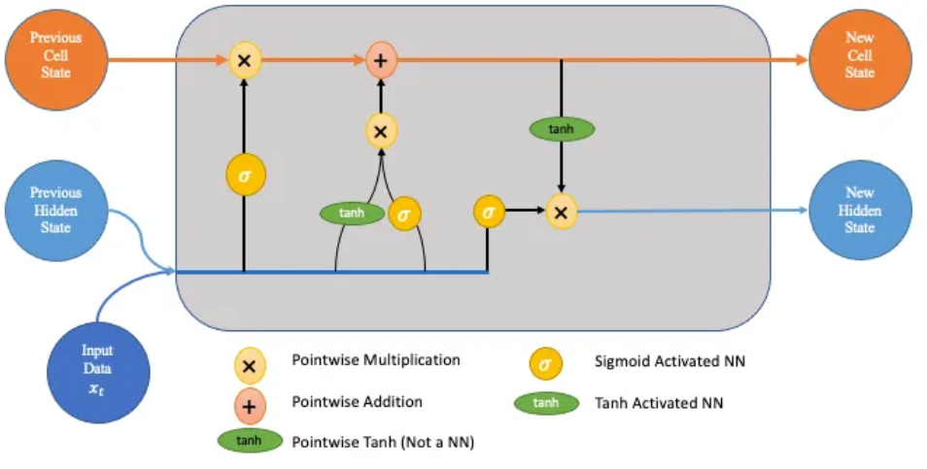
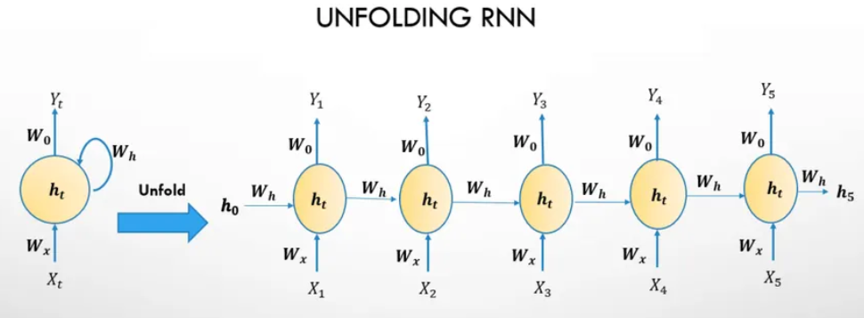
RNNs
LSTMs

Slide 13
Limitations of RNNs and LSTMs
Sequential bottleneck: Cannot parallelize well during training.
Vanishing gradients: Long sequences lead to information decay.
Hard to capture long-term dependencies even with LSTM's memory gates.
Slow and inefficient for large datasets or real-time applications.
Example: while translating a long sentence, RNNs may forget the subject by the time they reach the verb.
Even bidirectional LSTMs only partially solve this issue and still have computation limitations.

Slide 14
Transformer Architecture – A Paradigm Shift
Transformers attend to every word in the sentence in parallel using self-attention.
Key components:
Self-attention mechanism
Multi-head attention
Positional encoding
Feed-forward networks
The model can “weigh” the importance of each word globally in context.

Slide 15
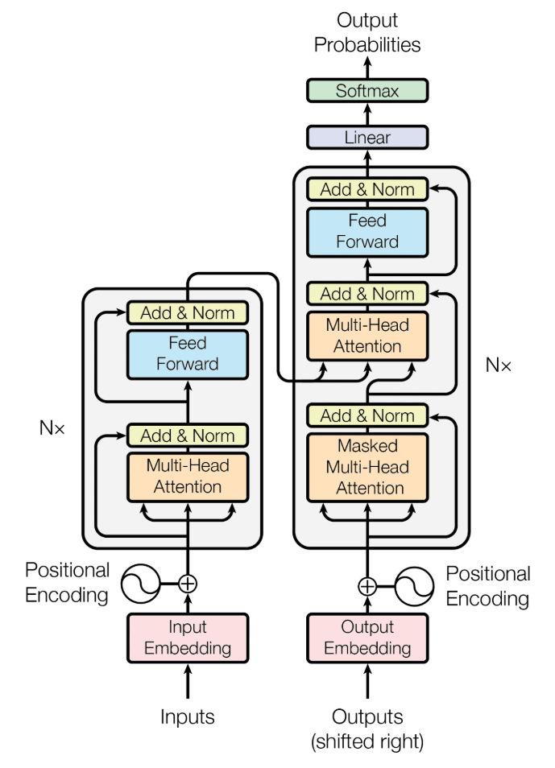

Slide 16
Global Attention – The Heart of the Transformer
Each word attends to all other words in the input through attention scores.
Captures long-range dependencies instantly.
Attention = Query × Key → Softmax → weighted sum of Values.
Enables better representation of context, grammar, and meaning.
Example: In “The cat that sat on the mat was black,” the word "was" attends to "cat" (not just "mat").
Attention lets the model dynamically decide which words are relevant.

Slide 17
A must read…
Vaswani, A., Shazeer, N., Parmar, N., Uszkoreit, J., Jones, L., Gomez, A.N., Kaiser, Ł. and Polosukhin, I., 2017. Attention is all you need. Advances in neural information processing systems, 30.
https://proceedings.neurips.cc/paper/2017/file/3f5ee243547dee91fbd053c1c4a845aa-Paper.pdf

Slide 18
Parameters

Slide 19
What Are Parameters in Language Models?
Parameters are the weights/unknowns learned during training.
They encode the model’s knowledge and determine how it predicts the next word/token.
More parameters → greater capacity to capture language patterns, but this is not always better.
Examples:
GPT-2: ~1.5B parameters
GPT-3: 175B
More parameters mean more model complexity but also higher computational cost.

Slide 20
How much memory does an LLM take up?
Let’s say your model has 20 billion parameters
How much memory will it need?
Do you need all that memory in RAM?
Is the required memory just the sum of all the space taken by the parameters?

Slide 21
How much memory does an LLM take up?
For a 20B model,
Size of each parameter: 4 bytes
Size of model in bytes: 20,000,000,000 * 4 = 80,000,000,000
≈80GB
What about the memory taken up by params like K, V?
Common convention to approximate required memory as 1.2*(size of params)
Our 20B mode will need 1.2*80GB ≈ 96GB
No, we don’t need it all in the RAM
Painfully slow if not in RAM

Slide 22
Context Window
The context window defines how much text the model can consider at once (measured in tokens).
A model with a small context window will forget the beginning of a long document.
Common sizes:
GPT-3: 2048 tokens
GPT-4: up to 128k tokens (depending on version)
Important for tasks like summarization, reasoning, code understanding, etc.
Newer models like GPT-4o and Claude 3 Opus can handle entire books or multi-turn conversations.

Slide 23
Temperature
Temperature controls the randomness of the model’s output.
Scale:
Low (e.g., 0.1): More deterministic, safer, factual.
High (e.g., 1.0 or more): More creative, diverse, but possibly inconsistent.
Formula-wise: It modifies the softmax function to make probabilities sharper (low T) or flatter (high T).
For coding, summarization → use low T; for poetry, story writing → use high T.

Slide 24
Top_p (Nucleus Sampling)
Top_p controls how many probable words the model can choose from.
Instead of picking from the top ‘k’ fixed words, it selects from a dynamic set of words whose cumulative probability ≤ p.
Example:
top_p = 0.9 → pick from the smallest set of words whose total probability is ≥90%.
Helps balance creativity and coherence.
Top-p is an alternative to temperature or can be used with it.
Higher top_p gives more diversity but can risk hallucination; lower top_p is more conservative.

Slide 25
Quantization

Slide 26
What is Quantization?
Quantization reduces the precision of numbers used in model computations (e.g., from 32-bit floats to 8-bit integers).
Used to compress models and reduce memory/computational cost.
Two main types:
Post-training quantization
Quantization-aware training
Popular in deploying ML models to edge devices, mobile, or cloud environments.
Think of it like using rough estimates instead of exact numbers to speed things up.

Slide 27
Performance Benefits of Quantization
Smaller model size: Up to 4x reduction when converting from FP32 to INT8.
Faster inference: Integer operations are faster and more hardware-efficient.
Lower memory usage: Less RAM and bandwidth needed to load or run models.
Energy efficiency: Critical for mobile/IoT and data center inference at scale.
This is why quantized models are widely used in mobile apps like Google Translate, on-device assistants, etc.
Quantization is essential for real-time applications like speech and image recognition on edge devices.

Slide 28
Efficiency Gains in Real-World Deployments
Enables ML models to run on resource-constrained hardware (microcontrollers, phones, FPGAs).
Supported by modern hardware: NVIDIA TensorRT, Qualcomm AI Engine, Apple Neural Engine, etc.
Reduces inference time, especially when batch sizes are small.
Examples:
BERT quantized → 2-3x faster with minimal accuracy loss
LLMs like LLaMA or GPT models often quantized for local deployment
Quantization makes large models accessible in low-resource settings.
Tools like ONNX, Hugging Face Transformers, and TensorFlow Lite offer quantization options.

Slide 29
Drawbacks and Challenges of Quantization
Accuracy loss: Some models degrade in performance, especially in sensitive tasks (e.g., medical, finance).
Difficult to quantize all layers: Some layers (like softmax) are harder to quantize effectively.
Limited support for quantization-aware training in some frameworks.
Hardware compatibility: Not all CPUs/GPUs accelerate INT8 or lower precision natively.

Slide 30
Caution!
Quantization isn’t plug-and-play in every case—trial and error or re-training may be needed. Models trained on narrow distributions or with sharp decision boundaries may suffer more accuracy loss.
When to use? Deploying on mobile/edge, speeding up inference, reducing model size.
Great for: speech recognition, image classification, NLP inference at scale.
Trade-off: speed and memory savings vs. slight potential drop in accuracy.
Future trend: mixed-precision inference (e.g., FP16 + INT8) for better balance.

Slide 31
Training

Slide 32
How are LLMs Trained?
Language models learn to predict the next token in a sequence (causal or masked).
Training involves self-supervised learning on massive corpora of text.
Core idea: convert large text datasets into input-output pairs without manual labeling.
Process: Tokenization → Forward pass → Loss calculation → Backpropagation → Parameter updates.
LLMs don’t need labeled data—just a lot of raw text (books, websites, code, etc.)
Training sources: Wikipedia, Common Crawl, GitHub, etc...

Slide 33
Base Models – Foundation of All Tasks
Base models are trained from scratch using general-purpose text.
No task-specific tuning—trained with a single objective, like next-word prediction.
Examples: GPT-3 (base), BERT (base), LLaMA (base).
Act as general-purpose learners: can be adapted later via prompts or fine-tuning.
Think of base models as a "blank canvas" that understands language broadly but doesn’t specialize in any task.
They are the raw form of models before being customized for chatbots, summarizers, translators, etc.

Slide 34
Fine-Tuned Models – Adapting for Specific Tasks
Fine-tuning = training a base model further on specific datasets or instructions.
Uses supervised learning or reinforcement learning with human feedback (RLHF).
Examples:
instruct-models= base models fine-tuned to follow instructions.
ChatGPT = base GPT + RLHF + safety tuning.
Fine-tuning teaches the model how to behave for a particular use case (chat, translation, etc.).
Fine-tuning adds task-specific intelligence and often improves alignment with user intent.
RLHF involves humans ranking responses, guiding the model toward preferred behavior.

Slide 35
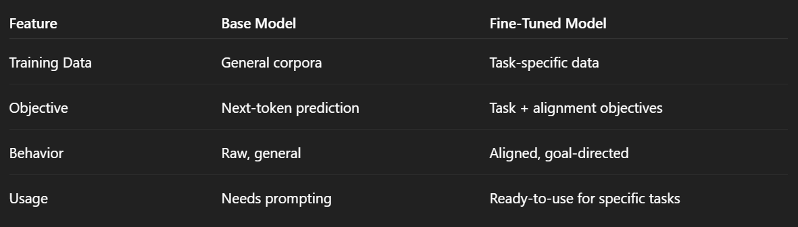
Key Differences – Base vs Fine-Tuned Models

Slide 36
An Example…
Those huge manuals that come when a buy a car or a bike - does anyone ready them?
What if we train an LLM on this manual and let users ask questions?
How to train the model - Corpus vs Q/A?
Advantages of training only on the corpus?
Advantages of training on Q/A?

Slide 37
RLHF

Slide 38
What is RLHF?
Short for Reinforcement Learning from Human Feedback
A method to fine-tune language models so they:
Follow instructions better
Are safer, less toxic
Align more with human intent
Three Stages of RLHF
Supervised Fine-Tuning (SFT)
Reward Model Training
Reinforcement Learning (PPO)

Slide 39
Why RLHF?
Solves problems of truthfulness, helpfulness, and harmlessness
Makes models better at following instructions
Helps align models with human values, not just raw likelihood
Associated challenges:
Expensive (requires human labelers)
Reward models can be biased
Can lead to reward hacking if not careful

Slide 40
Structured vs Unstructured Tasks

Slide 41
What is a task?
LLMs are nothing but next-token-predictors!!!
Their task is to generate the next token and then based on the sequence until now, again generate the next token.
A "task" refers to the kind of problem you're asking an LLM to solve — this could be answering a question, summarizing a document, extracting information, etc.
Goal: Explain that tasks can differ based on the input-output format and the structure of the expected response.

Slide 42
What are unstructured tasks?
Definition: These are tasks where the output is free-form text, and there’s no strict format.
Examples:
Answering a question like “What is the capital of France?”
Writing a paragraph summarizing an article.
Generating a poem or story.
LLM Behavior: The model uses its understanding of language to generate coherent, natural text.
Analogy: Like asking a person to explain something in their own words — flexible, creative, varied responses.

Slide 43
Examples
Task 1: Given a page from a medical document, extract the patient’s name, date of birth, marital status, race, religion in a JSON format.
Task 2: Generate a limerick

Slide 44
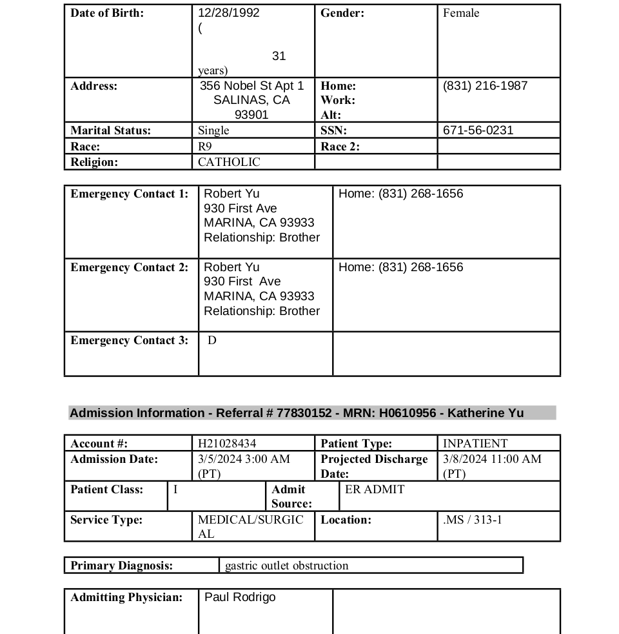
Task 1

Slide 45
Task 2
What is a limerick?
Prompt?

Slide 46
What are structured tasks?
Definition: These tasks require the model to output data in a specific format, usually machine-readable — e.g., JSON, lists, tables, or key-value pairs.
Examples:
Extracting structured information from a resume.
Converting user input into a database query.
Categorizing text and assigning structured labels (e.g., for sentiment, topic, etc.).
LLM Behavior: The model follows format instructions to produce a consistent structure. Often needs careful prompt design ("format your response as JSON").

Slide 47
Questions to ponder
Can you get the exact same output each time?
When do you need reproducible outputs?
Why is reproducibility a challenge?
Is there any dependence on hardware?

Slide 48
Retrieval Augmented Generation (RAG)

Slide 49
RAG
What do you understand from the name?
Two steps:
Retrieval
Augmented Generation

Slide 50
Why do we need RAG?
Consider the following tasks:
Asking an LLM about the procedure for applying leave in your college
Who won yesterday’s IPL final?
Did it rain yesterday?
What seems to be the problem here?

Slide 51
Answers
LLMs have a fixed memory: Once trained, they don’t know anything that happened after the training cutoff.
Which means they can hallucinate when asked about something that happened after the cutoff date
Consider the example in which you want to know the the procedure for applying a leave in your college or office?
This data is not publicly available. It may be present in the handbook that you receive.

Slide 52
So how does RAG work?
RAG combines retrieval (fetching relevant documents) with generation (LLM generating responses based on those documents).
Two-step process:
Retrieve: Search a knowledge base (vector database, documents, etc.) for relevant information.
Generate: Pass retrieved content + original query to the LLM to answer accurately.
Analogy: Like a student looking up class notes or a textbook before answering a tough exam question.

Slide 53
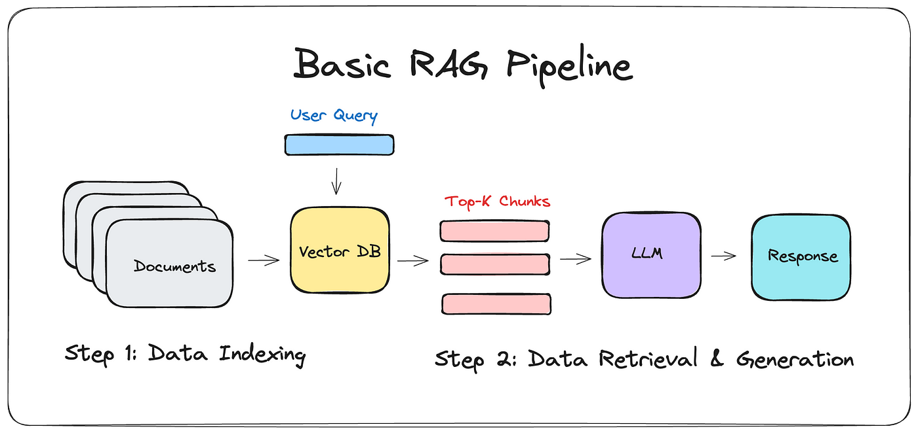

Slide 54
A Deeper Dive into RAG
What do you have to begin with?
_____
Can you / do you want to process them all at once?
___
So what can you do?
_____
Now you have ___. Will you store them as is?
_____

Slide 55
A Deeper Dive into RAG
No. Then how?
_____
Why ____?
_____
Now we have _____ in the _____
User asks a query. What do we do?
________
________
________

Slide 56
A Deeper Dive into RAG
Can LLMs understand ___? Will we show users the _____?
No and No
Get them back into ______
Give LLM: _____ and prompt.
ANSWER!

Slide 57
Tools and Tool calling

Slide 58
Tools in the context of LLMs
Definition: Tools are external functions or APIs that an LLM can call to perform specific tasks it cannot handle internally (e.g., math, web search, database query).
Goal: Make LLMs more useful, interactive, and grounded in real-time data or system states.
Analogy: Just like a programmer might Google something, use a calculator, or access a database, LLMs can use tools to “extend” their capabilities.

Slide 59
Why do LLMs need tools?
LLMs are stateless and lack real-world awareness.
What is the implication of stateless?
Struggle with accurate arithmetic or code execution.
Ask an LLM about the 235235th prime number
Can’t access real-time or external data by themselves.
Ask an LLM about today’s weather
Tools help LLMs interface with the outside world — like a plugin system.
Ask an LLM to find the customers who bought the most items from a DB

Slide 60
Core Concept of Tool Calling
So instead of making LLM do things, we want to make them decide what to do and when to do something.
This gives us much more control on what LLMs can access and do by having a deterministic steps/actions
For e.g. you don’t want the LLM to even accidentally delete all rows of a DB even if someone says that.
With these features, tool calling makes LLMs so much more powerful because it’s skill to do a task can plateau over time but to make a decision is much easier.

Slide 61
How to use Tool Calling
{
"name": "getWeather",
"description": "Get current weather for a given city.",
"parameters": {
"type": "object",
"properties": {
"city": {
"type": "string",
"description": "City name"
}
},
"required": ["city"]
}
}

Slide 62
An example
User Query: How’s the weather in Paris?
Available Tools: a get_weather function that needs the city and time
Flow:
User query is sent to the LLM with the required schema
The LLM output will be according to scheme say, function_name: get_weather, arguments: {‘city’: ‘Paris’}
We will add the current time to the function using the time module in python
So the function call will become get_weather({‘city’: ‘Paris’, ‘time’: ‘May 30th 2025’})
Now, we can execute this function dynamically, get an answer and return it to the user.
This is the foundation every tool calling architecture
As mentioned above, tool calls are like steroids for LLMs
Also forms the basis for LLMs as agents
Notes:
Can talk about what will happen if given multiple tools

Slide 63
Challenges
LLM Hallucination
Might call the wrong function or make up arguments
Schema adherence
May spit out incorrect or malformed tool call
Planning
A single LLM call may struggle to plan multi-step tool usage

Slide 64
Agents

Slide 65
What is an Agent?
Definition: An agent is an LLM-based system that can:
Understand a task
Decide which tool to use
Plan a sequence of actions
Execute tools iteratively to achieve a goal.
Analogy: An agent is like a software intern: understands high-level goals, figures out how to solve them step-by-step.

Slide 66
Why Agents?
The biggest advantage of using agents is to allow scope for rectifying what an LLM generated.
Examples:
Ask an LLM to build a full stack application. The problem is that it will try to do everything in one shot. If if realizes that it made a mistake, it cannot correct it.
Even in reasoning tasks, an agentic setup will ensure that if one agent made a mistake, it can be rectified in the next iterations before sending out the answer.

Slide 67
Classic Example
Assume you want an “agent” to generate a response and we need it to be be a perfect json.
What system can you setup?
What will be the roles?
Is agentic the only way?
Are other options also a form of “agentic” system?

Slide 68
Comparison
Capability | Plain LLM | Tool Calling | Agent
Understand task | ✅ | ✅ | ✅
Use external functions | ❌ | ✅ | ✅
Multi-step reasoning | ❌ | Limited | ✅
Select tools dynamically | ❌ | 🚧 Hardcoded | ✅
Keep state / memory | ❌ | 🚫 (stateless) | ✅ (often)
Plan + execute tasks | ❌ | 🚫 No control flow | ✅

Slide 69
Overview of Typical Agentic Architecture
Main components:
LLM – for reasoning and generation
Toolset – available APIs/functions it can use
Planner – (optional) generates a step-by-step plan
Executor/Loop – decides what to do next (often looped until task is done)
Memory (optional) – stores past actions, intermediate results

Slide 70
Core Loop of an Agent
ReAct loop: Reasoning + Acting + Observing
Receive task (e.g., “Find the cheapest flight from NYC to Paris”)
Decide next action (Search flights? Filter options?)
Call tool (e.g., flight API)
Observe result (list of flights)
Repeat if needed (sort, re-query, book)
Return final result (best flight)

Slide 71
Challenges in Agentic Systems
LLM hallucination – may make up tools or misinterpret outputs
Infinite loops – agents may get stuck repeating steps
Latency – slower than basic tool use due to multiple steps
Testing is hard – deterministic evaluation is difficult
Maintaining observability requires considerable efforts

Slide 72
Questions?
Notes:
Can talk about what will happen if given multiple tools

Slide 73
Acknowledgements
Sudha Sree Yerramsetty (MS Computer Science, University of Illinois Chicago)
Notes:
Can talk about what will happen if given multiple tools

